Slide 1
Writing Instructions
Guiding a reader through a process

Slide 2
Role of instructions & manuals
Documents written most by technical communicators
Other communicators write instructions for formal docs (manuals) and information docs (emails, memos)
Critical to making products, procedures, and systems safe and “user friendly”

Slide 3
Analyzing Audience
Background (social, education)
Skill level
  Use appropriate vocabulary
  Translate necessary terms
Needs and use

Slide 4
People read instructions in one of three ways:
Some, but only a few, read instructions all the way through before beginning to follow any of the steps
Others read and perform each step without looking ahead to the next
And still others begin a task without reading any instructions and turn to them only when difficulties arise

Slide 5
Since you have no way to control the third group, assume you are writing for readers who will read and perform each step without looking ahead. Therefore, all instructions must be in a strict chronological order

Slide 6
Don’t forget…
An incorrect audience analysis is the biggest reason why instructions and manuals fail
Language should always be clear, concise, and brief
Do not use long or complex sentences

Slide 7
A brief example…
(Shhh… no talking during this example)

Slide 8
Follow These Instructions
Take out a sheet of paper
Fold the paper in half (top to bottom)
On the right-hand side of the page, write the words “instructions test”
Fold the paper in half again (side to side– this will make your paper look like a greeting card)
Draw a smiley face on the front of the card
Write your name on the card
Fold the paper in half from top to bottom again
Ignore step five
Pass the paper to the instructor

Slide 9
Any problems?

Slide 10
Elements of Instructions
(short version)
General introduction
Step-by-step instructions
Conclusion

Slide 11
Elements of Instructions
(long version)
Everything from here on out.

Slide 12
Title
Use a specific title that accurately names the action covered in the instructions
  Poor: Snow Removal

Slide 13
Title
Use a specific title that accurately names the action covered in the instructions
  Poor: Snow Removal
  Better: Using Your Acme Snow Blower

Slide 14
Purpose
Explain the purposes of the instructions unless it is obvious (i.e., the purpose of a coffee maker)

Slide 15
Purpose & Audience
Explain the purposes of the instructions unless it is obvious (i.e. the purpose of a coffee maker)
  These instructions are for nurses who must inject dye into a vein through a balloon-tipped catheter
  This safe practices book is for employees who operate cranes and riggers

Slide 16
Writing Instructions (intro)
Have reader-centered title (what does the writer have to do?)
Have a clearly stated purpose that includes reader benefits
List parts, materials, and conditions

Slide 17
Parts, Materials & Conditions
If readers needs to gather items in order to follow the instructions, list those items in the introduction
Materials are the items needed to perform the task (sandpaper, shellac)
Tools are the implements needed (screwdriver, pliers, small paintbrush)
Conditions are special circumstances that are important for completing the task successfully, such as using a dry, well-ventilated room

Slide 18
Writing Instructions (steps)
Number (or otherwise organize) steps
Use present tense and imperative mode (and don’t omit articles – a, am, though, to create brevity)
Provide the right amount of info for each step
Separate steps from background info or tips

Slide 19
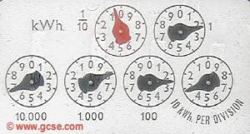
Be specific
Read a dial

Slide 20
Be specific
Read the dial

Slide 21
Be specific
Read the top dial

Slide 22
Be specific
Read the top left dial (in red)

Slide 23

Ambiguous wording, even in implied commands, leads to confusion

Slide 24
What’s wrong with this?
Take out two slices of bread
Spread the peanut butter on the bread
I like mine with marshmallows and Fritos
The knife needs to be washed
Put the lid back on the peanut butter

Slide 25
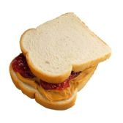
Is this better? Why?
Take out two slices of bread
Take out a clean knife
Spread the peanut butter on the bread
Wash the knife and place the lid back on the peanut butter
Note: I like to add marshmallows, and Fritos to my peanut butter sandwiches

Slide 26
Writing Instructions (conclusion)
Tell readers what to expect after following the instructions and suggest other uses and options if appropriate
  Your food will be hot, but not as brown as if heated in the oven rather than the microwave. A few minutes of standing time will complete the cooking cycle and distribute the heat uniformly

Slide 27
Organization & Design
Separate your instructions into logical pieces (chronological order)
Use relevant instructions/graphics
Make the sections of your instructions visually distinct
Separate and label info that isn’t directly part of your instructions

Slide 28
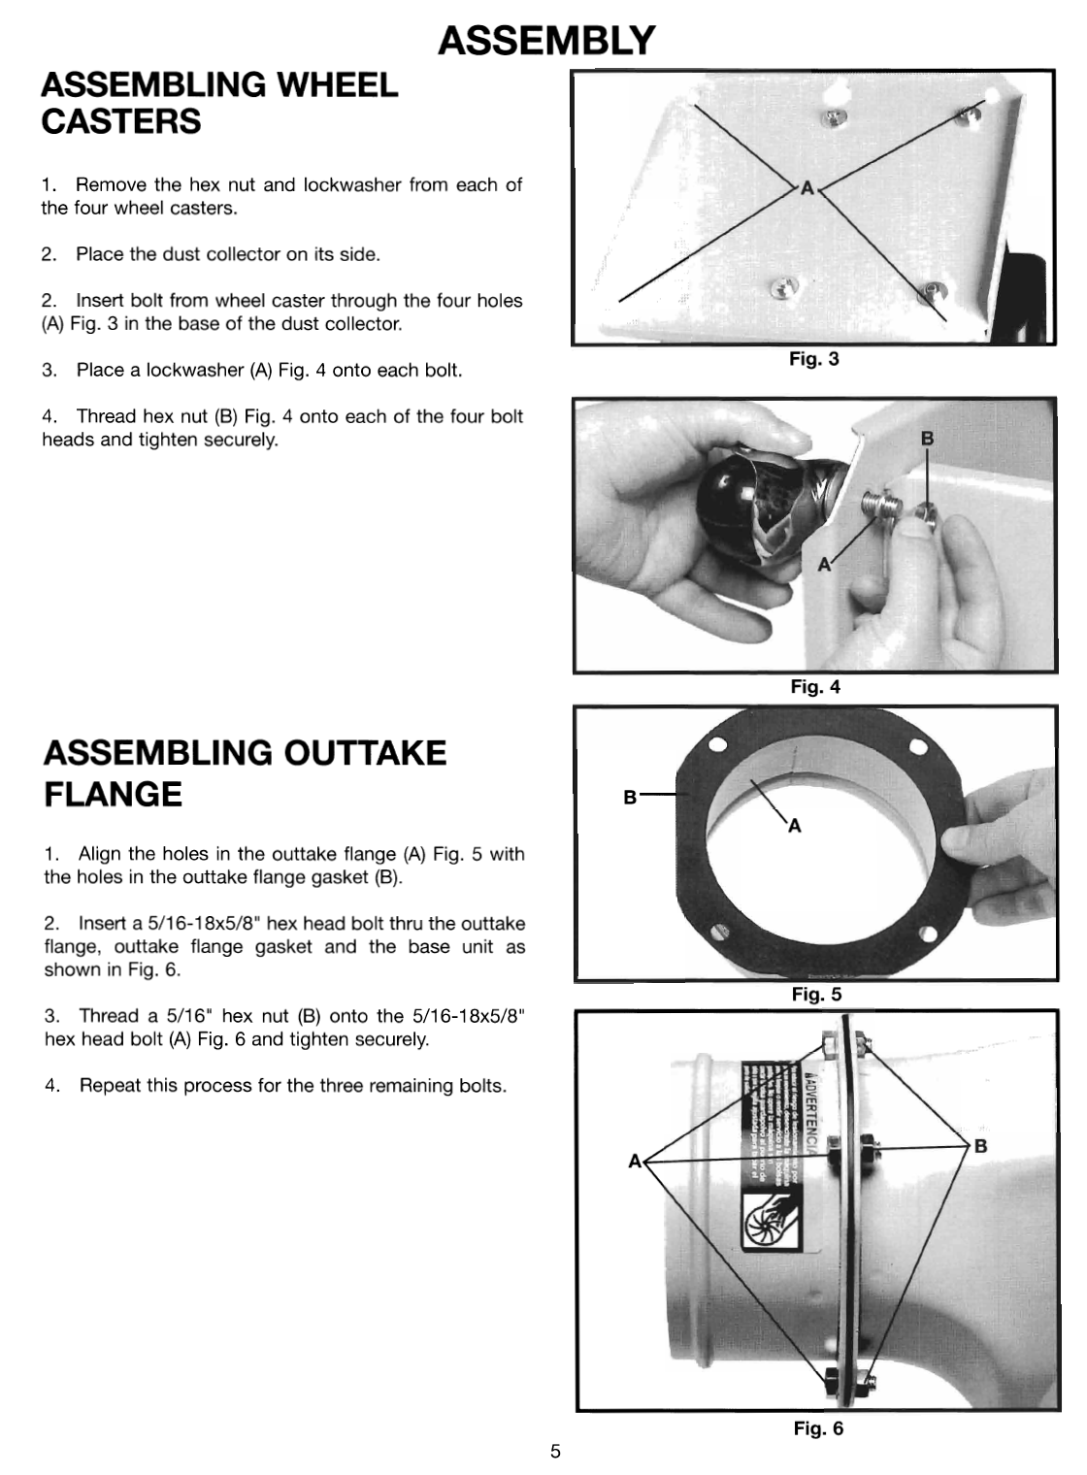
From Delta Dust Collector Instructions

Slide 29
Writing Safety Information
Place in prominent area on the page (Location, location, location)
The more critical the safety comment, the LARGER and MORE EMPHATIC it should be

Slide 30
Levels of Safety defined
Danger – likelihood of serious injury or death
Warning – potential for minor/moderate injury
Caution – potential for equipment damage
Note – suggestions for how to best carry out the task

Slide 31
A note about safety info
There is no universal language or definitions for safety terms
Because of liability issues, companies will not (and should not) ask you to write safety instructions unless you’re a professional technical communicator

Slide 32
Remember
Know your audience
Keep your instructions simple
Start with an introduction
Use a clear and effective visual hierarchy
DON’T SKIP STEPS JUST BECAUSE THEY SEEM OBVIOUS
Conclude with a summary or description
And, one more time, just so we’re clear on this…

Slide 33
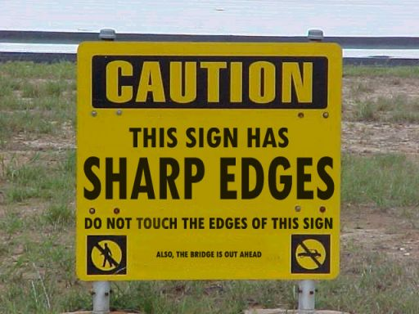
State the Obvious

